Slide 1

Healthcare Dashboard Insights Report

Slide 2
This Healthcare Analysis Dashboard is meticulously designed to serve as a cornerstone in modern medical practice, offering a detailed and interactive overview of patient data. The dashboard’s primary goal is to streamline the management of patient information, making it more accessible and actionable for healthcare providers.
📌 Key Aspects of the Dashboard:
📌 Patient Information Consolidation: The dashboard centralizes critical patient information, including personal demographics, medical history, and details of hospital admissions and discharges. This comprehensive data collection is pivotal for creating a holistic patient profile.
📌 Health Metrics Evaluation: It features advanced capabilities to track and analyze detailed blood test reports, providing healthcare professionals with vital health metrics. These include glucose levels, hemoglobin counts, and indicators of heart failure, among others, all crucial for diagnosing and monitoring patient health.
📌 Hospital Stay Analysis: The system records the duration of each patient’s hospital stay, including time spent in the ICU. This data is essential for assessing the efficiency of care provided and for planning future resource allocation to improve patient outcomes.
📌 Lifestyle Habit Documentation: Recognizing the impact of lifestyle choices on health, the dashboard documents smoking and alcohol consumption habits. This information is integral to tailoring patient care and developing personalized treatment plans.
📌 Discharge Planning: A dedicated section for discharge notes ensures that the patient’s condition upon leaving the hospital is clearly communicated, along with any follow-up care instructions. This facilitates continuity of care and supports patient recovery post-discharge.

Slide 3
Skills Utilized in Healthcare Dashboard Report
Data Analysis
Analysing patient data to extract insights.
Interpreting data and patterns.
Data Visualization
Creating intuitive charts and muti row cards.
Customizing visual elements for clarity.
UX Design
Crafting user-friendly interfaces.
Ensuring responsive design.
Presentation Skills
Organizing information effectively.
Enhancing visual appeal.
Tools Used
[ MS Excel and Power BI ]

Slide 4
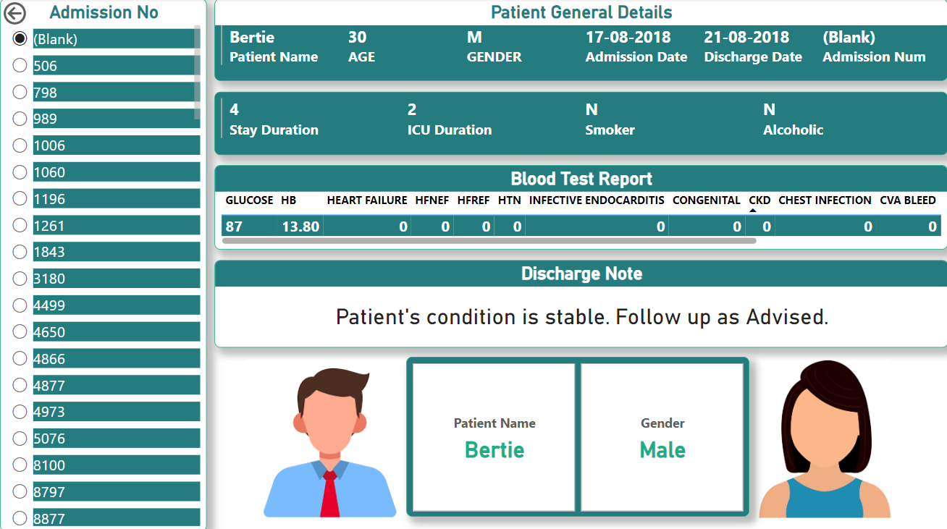

Slide 5
Healthcare Dashboard Project Overview
Objective: To develop a comprehensive healthcare dashboard that provides a consolidated view of patient data for enhanced medical decision-making and patient care.
Features:
Patient Database: A centralized system capturing essential patient information, including demographics, admission and discharge dates, and medical history.
Health Metrics Tracking: Integration of key health indicators such as blood test results, ICU duration, and lifestyle habits.
User Experience: A user-friendly interface designed for easy navigation and quick access to patient information.
Data Visualization: Utilization of charts and tables to present data in an easily digestible format.
Outcome:
The dashboard successfully aggregates patient data, offering healthcare professionals a holistic view of patient health and facilitating timely and informed medical interventions.
Future Enhancements:
Potential integration with electronic health records (EHR) for real-time data updates.
Implementation of predictive analytics for proactive patient care management.
This summary encapsulates the essence and capabilities of your healthcare dashboard project. Feel free to expand upon any section to align with your specific project details or goals. 🏥📈

Slide 6
Aim of the Dashboard
The overarching aim of this dashboard is to enhance the quality of healthcare delivery through meticulous data analysis. By providing a user-friendly platform that offers a comprehensive view of patient data, the dashboard empowers healthcare professionals to make informed decisions, ultimately leading to better patient care and improved health outcomes.
This expanded text provides a more detailed understanding of the purpose and capabilities of your Healthcare Analysis Dashboard, emphasizing its role in improving patient care and healthcare management. 🏥📊

